Slide 1
Chapter 2 Variables and Basic Data Structures
By
Hyung Jae (Chris) Chang
Troy University

Slide 2

Variables and Assignment
Variable is used to store information.
A variable is a string of characters and numbers associated with a piece of information.
The assignment operator, denoted by the “=“ symbol, is the operator that is used to assign values to variables in Python.
x = 2
2 is assigned to x.
We can view a list of all the variables in the notebook using the magic command “%whos”. (magic commands are a specialized set of commands host by the Ipython kernel and require the prefix % to specify the commands)

Slide 3
Variables and Assignment (cont.)
The mathematical statement x=x+1 has no solution for any value of x.
If x is assigned a value, the statement makes perfect sense.
Try these!
x = 1
x = x + 1
x
What do you see as an output?

Slide 4
Variables and Assignment (cont.)
When a variable is assigned, it has no memory of how it was assigned.
Please try these!
x = 1
y = x + 1
x = 2
y
What do you see?
Reassigning the value of x will not change the value of y.
You can clear a variable using the del function. Typing “del x” will clear the variable x from the workspace.
To remove all the variables, you can use the magic command “%reset”.

Slide 5
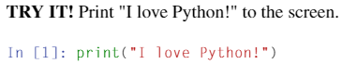
Data Structure – String
We have more data types where we can store multiple values: strings, lists, tuples, sets and dictionaries.
Let’s start with “string”.
A string is a sequence of characters, such as “Hello World”.
Strings are surrounded by either single or double quotation marks.
A blank space, “ “, between “I” and “love” is also a type “str”.

Slide 6
Data Structure – String (cont.)
Because string is an array of characters, it has length to indicate the size of the string; len() function returns total number characters in the string (including blank space(s)).
Try these!
s = “Hello World”
len(s)
What do you see?

Slide 7
Data Structure – String (cont.)
Strings also have indexes for the location of each character; the index of the position starts with 0.
We can also select a sequence as well using string slicing. The syntax for slicing in Python is [start:end:step] where the third argument, step, is optional. If it is not specified, the default value for the third argument is 1.
Try these!
s= “Hello World”
s[2]
s[2:7]
s[2:]
s[:7]
What do you see?

Slide 8
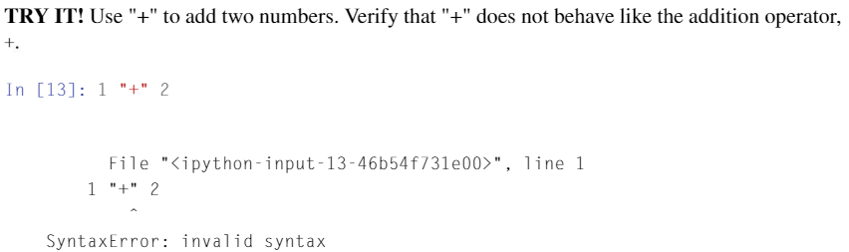
Data Structure – String (cont.)
You can also use a negative index when slicing the strings, which means counting from the end of the string. For example, -1 means the last character, -2 means the second to last and so on.
Try these!
s[6:-2]
s[7:-2]
What do you see?
s[::2] means print every other character in the variable “s”.
Strings cannot be used for mathematical operations.

Slide 9
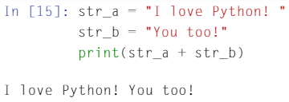
Data Structure – String (cont.)
Numbers can also be expressed as a string. For example, s=“123” means that s is the string 123, but not the number one hundred and twenty three. However, strings represent words or text and so should not have addition defined on them.
One string can be concatenated to another string.

Slide 10
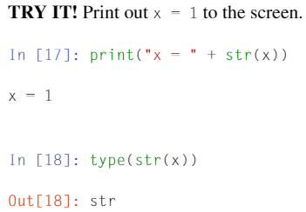
Data Structure – String (cont.)
We can convert number to string using str().
When 1 is assigned to variable x.

Slide 11
Data Structure – String (cont.)
In Python, string is an object that has various methods that can be used to manipulate it. To get access to these various methods, we use the form, “string.method_name”.
Uppercase function: variable.upper() – change all characters to uppercase
Count number of occurrences: variable.count(string) – count the number of occurrences of string in variable.
Replace specific word: variable.replace(string1, string2) – change string1 in variable to string2.

Slide 12
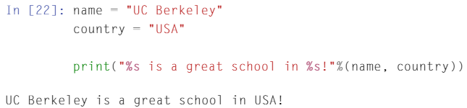
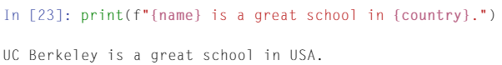
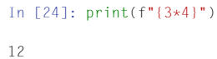
Data Structure – String (cont.)
There are 2 ways to preformat a string.
Using %s
Using f-string: formatted-string which is available in Python 3.6 and above.
In this way, we can even print out a numerical expression without converting the data type as we did before

Slide 13
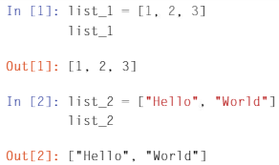
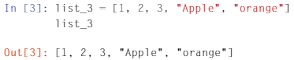
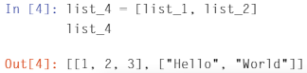
Data Structure – List
A more versatile sequential data structure in Python.
Used with a pair of brackets [ ]
The elements within the brackets are separated by commas
Can hold any type of data, such as numerical, strings or other types.
We can put mixed types or other lists in the list as well.

Slide 14
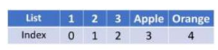
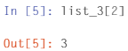
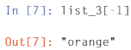
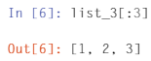
Data Structure – List (cont.)
The way to access the element in the list is similar to how it is done for strings: using index.
Colon also works to define the range/number of elements accessed.

Slide 15
Data Structure – List (cont.)
len() shows the length (the number of elements) of the list.
Concatenation
We can you + sign to concatenate two lists.
Or we can use append method from the list.
Try these!
list = [1, 2, 3]
list.append(4)
list
What do you see?

Slide 16
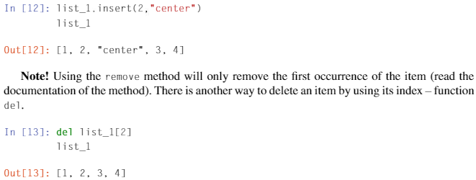
Data Structure – List (cont.)
insert(): Insert a specific data to specified index
del: remove a specific data from the list at the specified index location

Slide 17
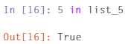
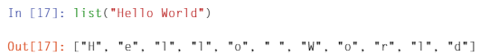
Data Structure – List (cont.)
in: checks whether specific element is in the list and returns true or false.
list: can be used as a function to turn sequence of items into list.

Slide 18
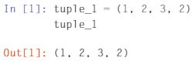
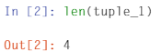
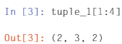
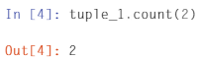
Data Structure – Tuple
Used with a pair of parenthesis ( ).
Elements are separated by commas.
As with strings and lists, there is a way to index tuples, slicing the elements and even some methods are very similar to those we saw already.

Slide 19
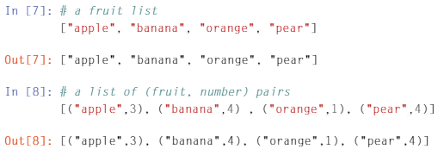
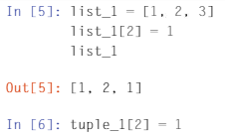
Data Structure – Tuple (cont.)
What is the difference between lists and tuples?
Why do we need both of them?
List | Tuple
List is mutable: elements can be changed. | Tuple is immutable: elements can’t be changed.
Elements are usually homogeneous. | Elements are usually heterogeneous where they are accessed via unpacking or indexing.

Slide 20
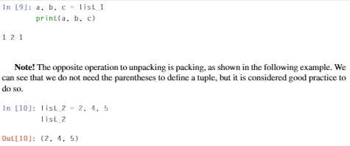
Data Structure – Tuple (cont.)
Tuples or lists can be accessed by unpacking, which requires the number of variables on the left-hand side of the equality sign be equal to the number of elements in the sequence.

Slide 21

Data Structure – Set
Used with a pair of braces { } where its elements are separated by commas.
Stores unordered collection with no duplicate elements.
Supports mathematical operations like union, intersection, difference and symmetric difference.
Union $A∪B$: set1.union(set2)
Intersection $A∩B$: set1.intersection(set2)
Difference$A−B$: set1.difference(set2)
Symmetric difference $(A∪B)−(A∩B)$: set1.symmetric_difference(set2)

Slide 22
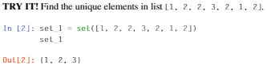
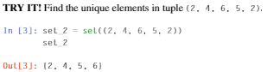
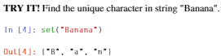
Data Structure – Set (cont.)
We can use “sets” to quickly determine the unique elements in a string, list or tuple.

Slide 23
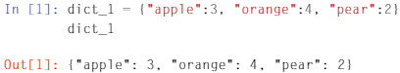
Data Structure – Dictionary
Used with a pair of braces { }
Instead of using a sequence of numbers to index the elements (such as lists or tuples), dictionaries are indexed by keys, which can be a string, number or even tuple (but not list).
Elements → key-value pairs where each key maps to a corresponding value.
Elements are separated by commas.

Slide 24
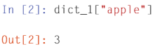
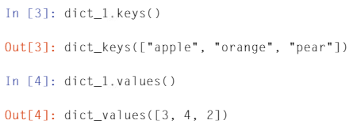
Data Structure – Dictionary (cont.)
Since elements in dictionary are stored without order, we can’t access a dictionary based on a sequence of index numbers. Rather, we need to use the key of the element: “dictionary[key]”
We can get all the keys in a dictionary by using the “keys()” method or all the values by using the method “values()”.

Slide 25
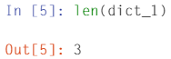
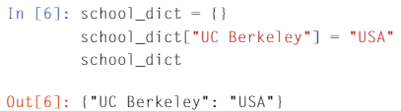
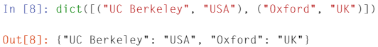
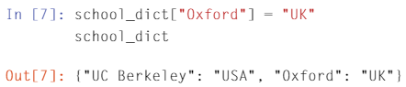
Data Structure – Dictionary (cont.)
len() function also works to get the size of a dictionary.
We can define an empty dictionary and then fill in the element later. Or we can turn a list of tuples with (key, value) pairs to a dictionary.

Slide 26
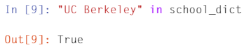
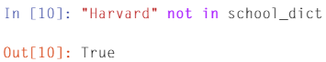
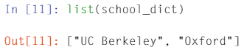
Data Structure – Dictionary (cont.)
“in” operator can be used to check a specific element in the dictionary.
“list” turns keys of dictionary to list.

Slide 27
Data Structure – Arrays
NumPy module is used to use/handle arrays in Python.
NumPy is one of the most fundamental numerical computing modules in Python.
NumPy has very important features, and few of them are
A powerful N-dimensional array object
Sophisticated (broadcasting) functions
Tools for integrating C/C++ and Fortran code
Useful linear algebra, Fourier transform and random number capabilities
In order to use NumPy, you have to import NumPy module by typing “import numpy as np”. Here, np is conventional shorted name used for numpy. You may use different names.

Slide 28
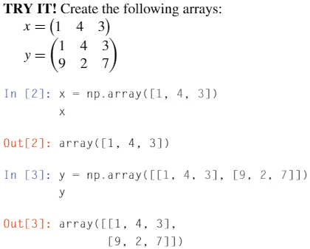
Data Structure – Arrays (cont.)
We can use array() function to convert a list to an array.
A 2-D array can be created using nested lists with the inner list representing each row.

Slide 29
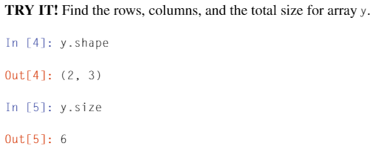
Data Structure – Arrays (cont.)
variable.shape: not a function, but an attribute that stores a tuple of size of each dimension of the array.
variable.size: not a function, but an attribute that stores the total number of elements in the array.

Slide 30
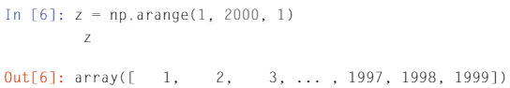
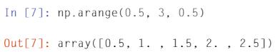
Data Structure – Arrays (cont.)
We can generate arrays with many in-order data points which have a structure or pattern evenly spaced by using arange() function in NumPy.

Slide 31
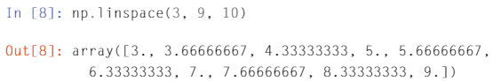
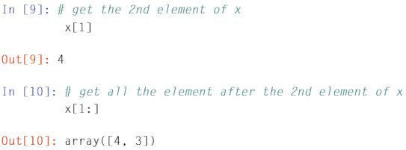
Data Structure – Arrays (cont.)
We can use linspace() function with fixed start and end points with evenly spaced elements.
The linspace() function takes three arguments, starting point, ending point and the number of elements.
We can use index to indicate the location in an array like lists or tuples.

Slide 32
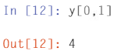
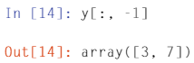
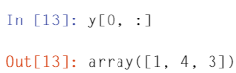
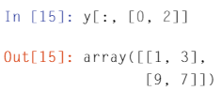

Data Structure – Arrays (cont.)
To access elements in a 2D array M, we use M[r, c] where the row r and column c are separated by a comma; this is referred to as “array indexing”.
The r and c can be single number, a list, etc.
Assume that we have x = ($\begin{matrix}1 & 4 & 3 \\ 9 & 2 & 7\end{matrix}$)

Slide 33
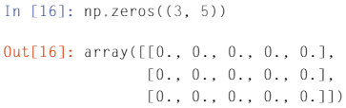
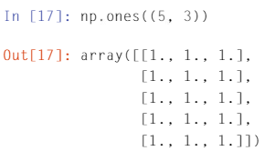
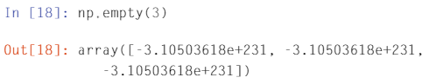
Data Structure – Arrays (cont.)
There are some predefined arrays that are useful: np.zeros, np.ones and np.empty (where np is a shorted-name for NumPy).
The empty array is not really empty, but it is filled with very small random numbers.

Slide 34






Data Structure – Arrays (cont.)
Basic arithmetic operations are possible between scalar (a single number) and an array.
Let b= ($\begin{matrix}1 & 2 \\ 3 & 4\end{matrix}$).

Slide 35






Data Structure – Arrays (cont.)
Basic arithmetic operations are possible between two arrays.
Let b= ($\begin{matrix}1 & 2 \\ 3 & 4\end{matrix}$) and d= ($\begin{matrix}3 & 4 \\ 5 & 6\end{matrix}$).

Slide 36


Data Structure – Arrays (cont.)
We can do transposition of an array in Python. The transposition switches the rows and the columns of an array.
Let b= ($\begin{matrix}1 & 2 \\ 3 & 4\end{matrix}$).

Slide 37

Data Structure – Arrays (cont.)
Logical operations are defined only between a scalar and an array and between two arrays of the same size.
The logical operation is conducted between the scalar and each element of the array.
Between two arrays, the logical operation is conducted element-by-element.

Slide 38

Data Structure – Arrays (cont.)
Python can index elements of an array that satisfy a logical expression.

